Slide 1
Wait List Application

Slide 2
Functionality Required in the Application:
The app allows a potential customer to sign up to the waiting list with his email
address. (he will see a screen with an email address)
As soon as he signs up, his position in the waiting list will be displayed. (The first customer gets the default number of 99. When the next customer signs up, his waiting list position is 100)
Once he signed up for the waiting list, he will get a unique referral link - He
can share this link to his friends.
If their friends sign up using his referral link, he will “move up” by 1 place in his position (Example: John has joined the wait list at position: 120. He referred 10 of his friends. When they joined, John’s position will go to 110)
Once a customer reaches Position 1, he will receive an email with a coupon code to
purchase the new product.

Slide 3

TECH STACK

Slide 4
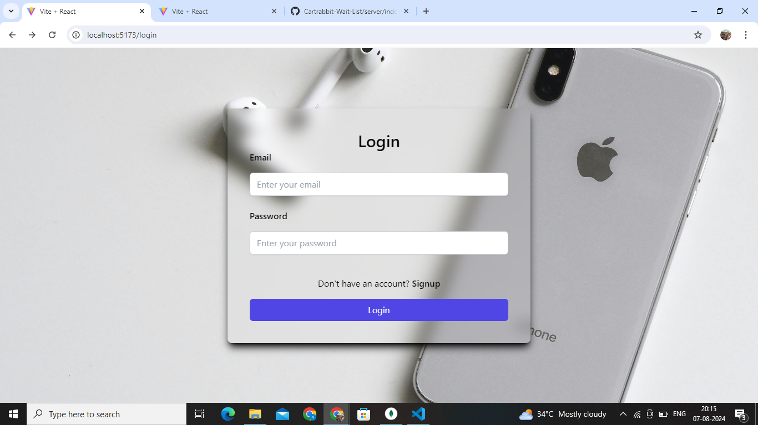

Slide 5
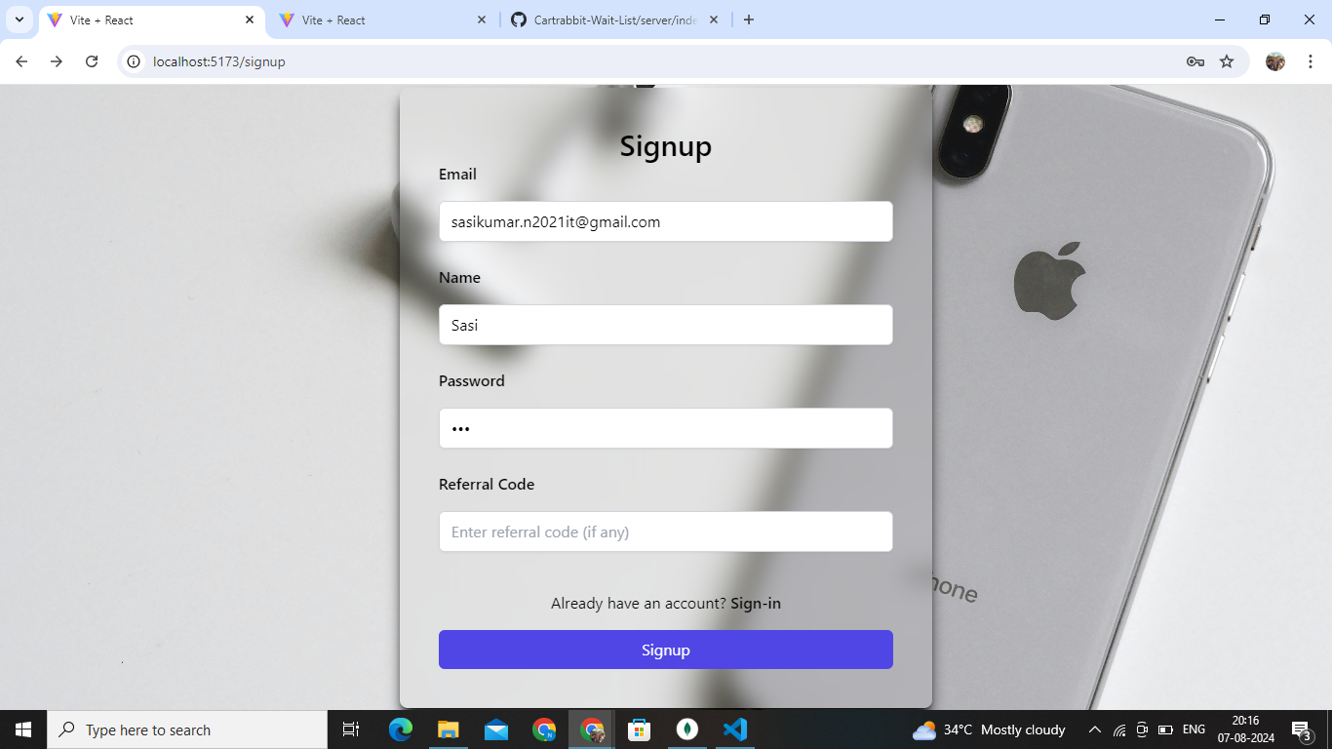

Slide 6
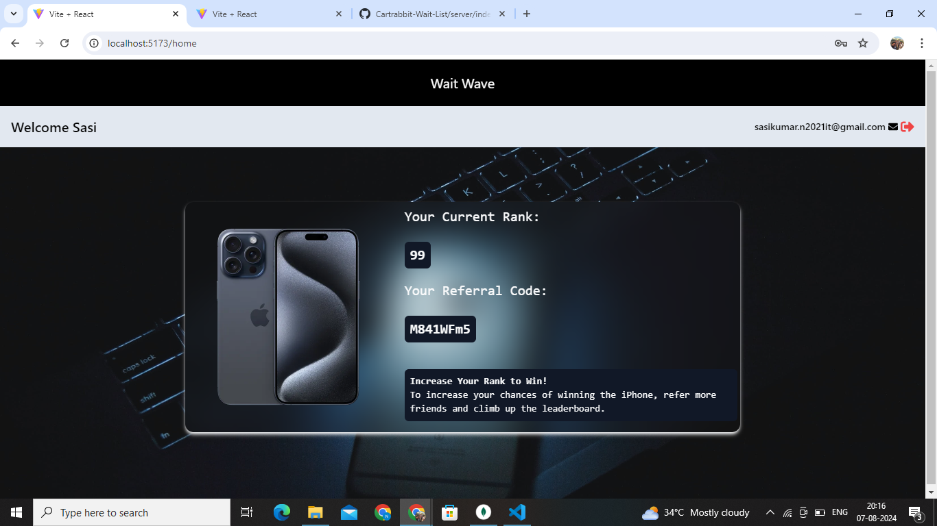

Slide 7
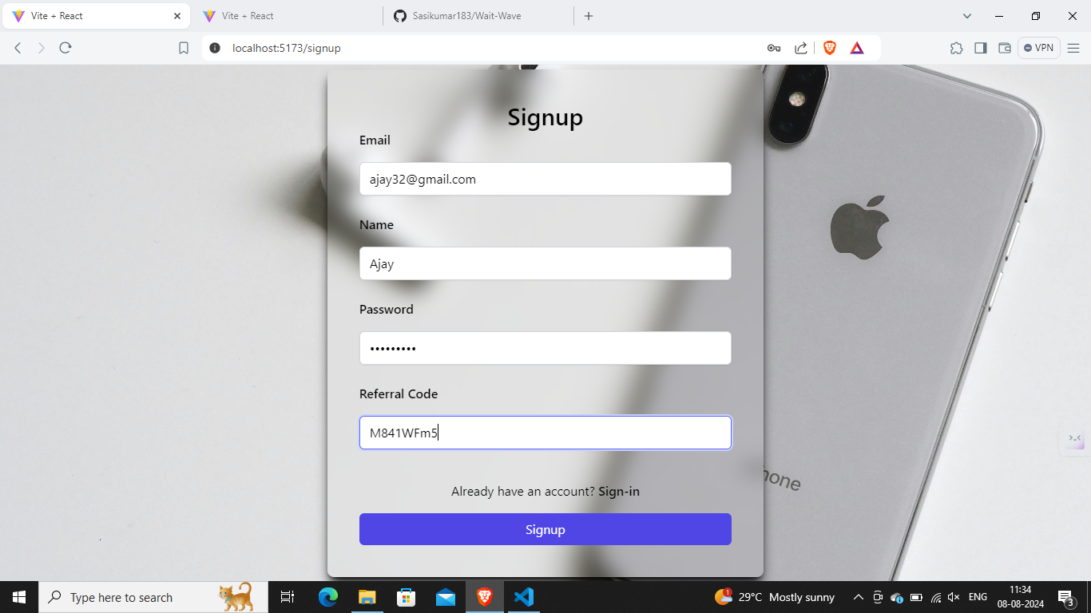

Slide 8


Slide 9


Slide 10
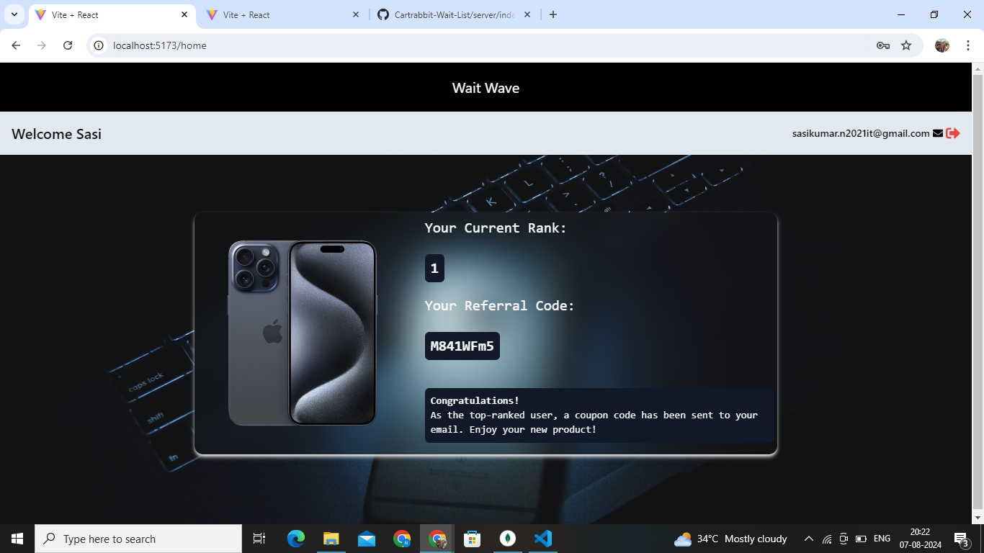

Slide 11
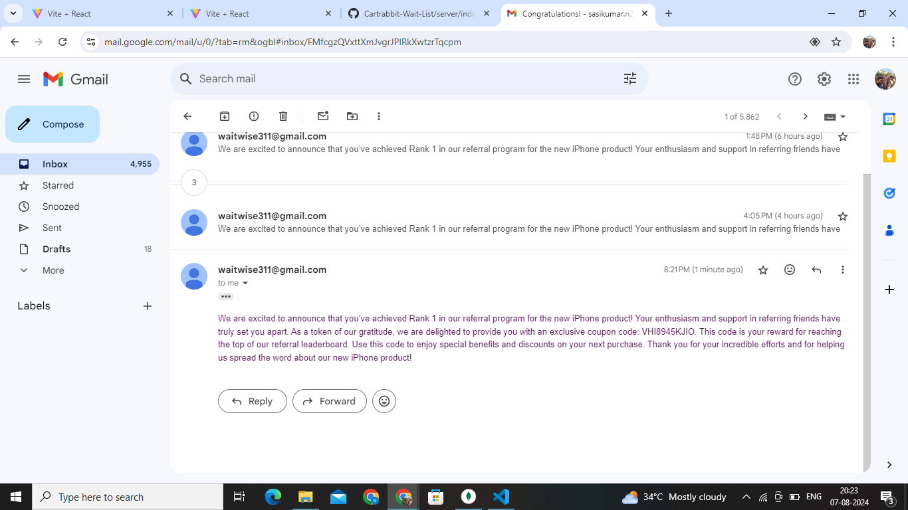

Slide 12
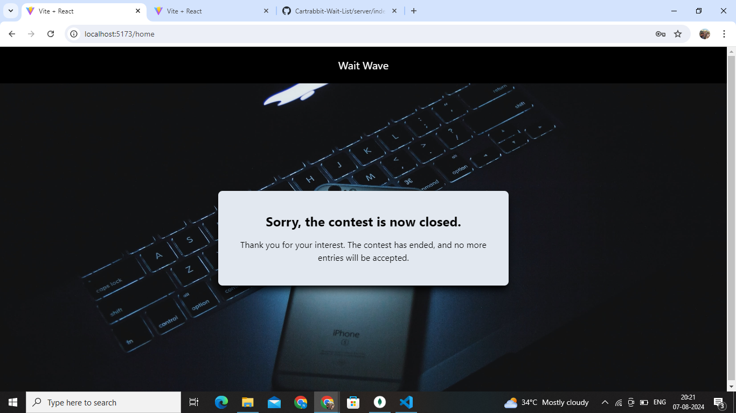

Slide 13
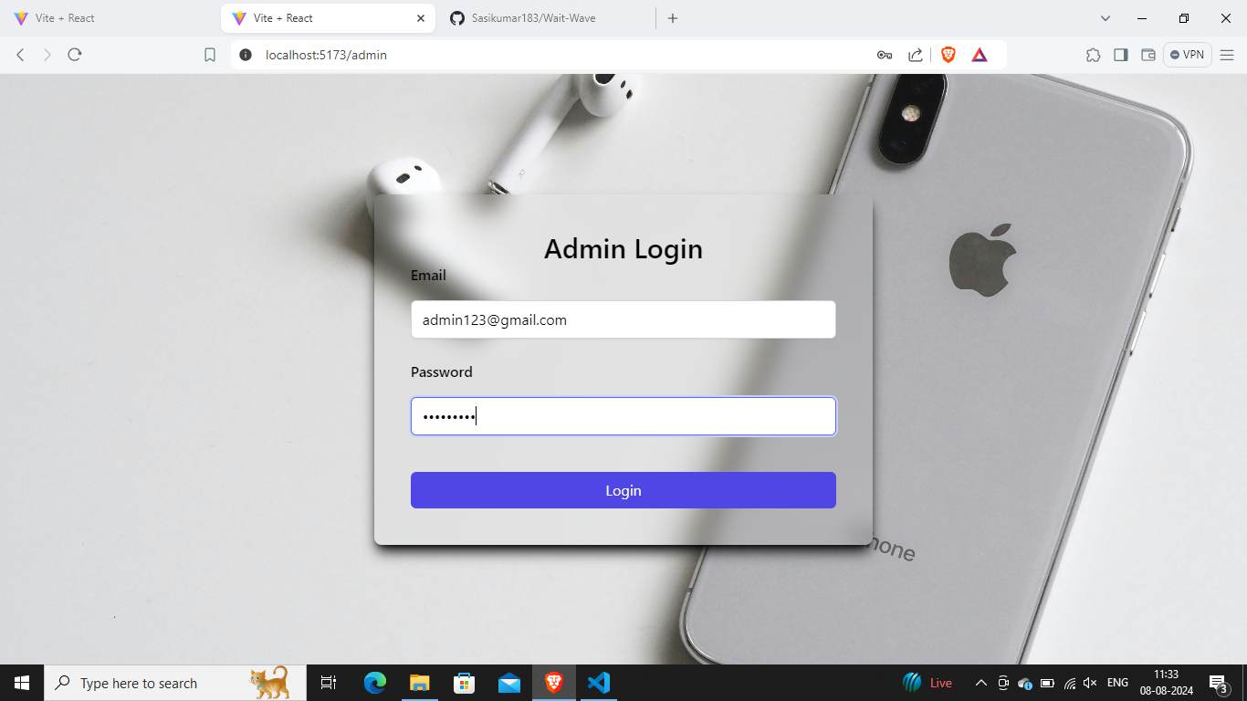

Slide 14
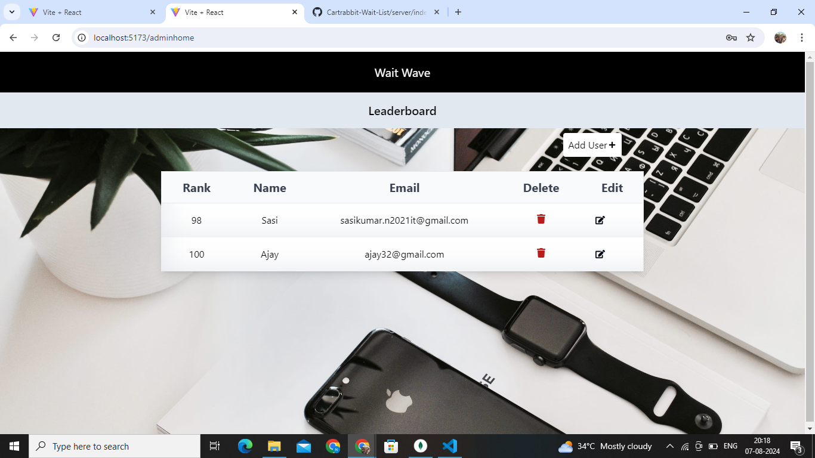

Slide 15
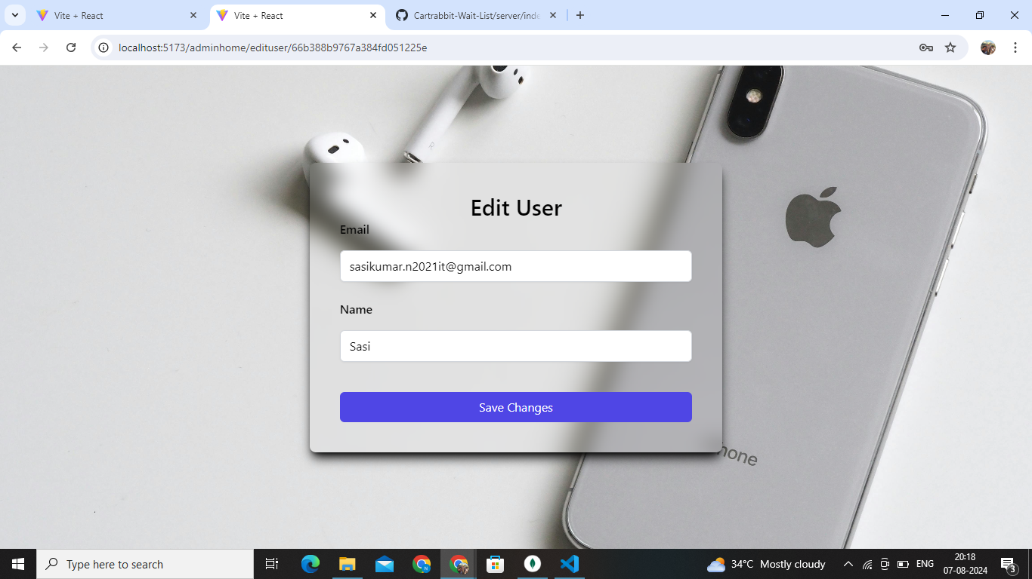

Slide 16
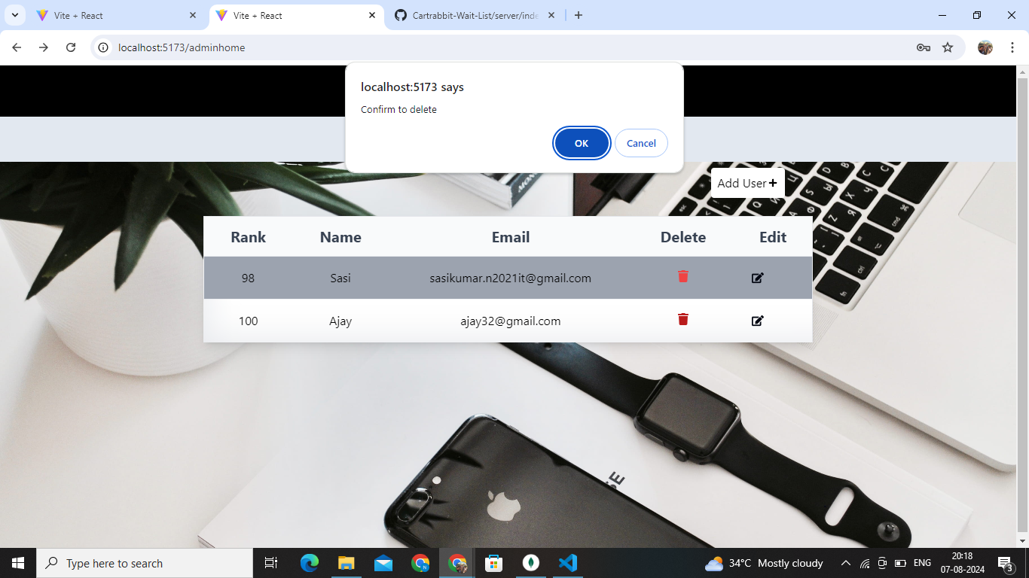

Slide 17
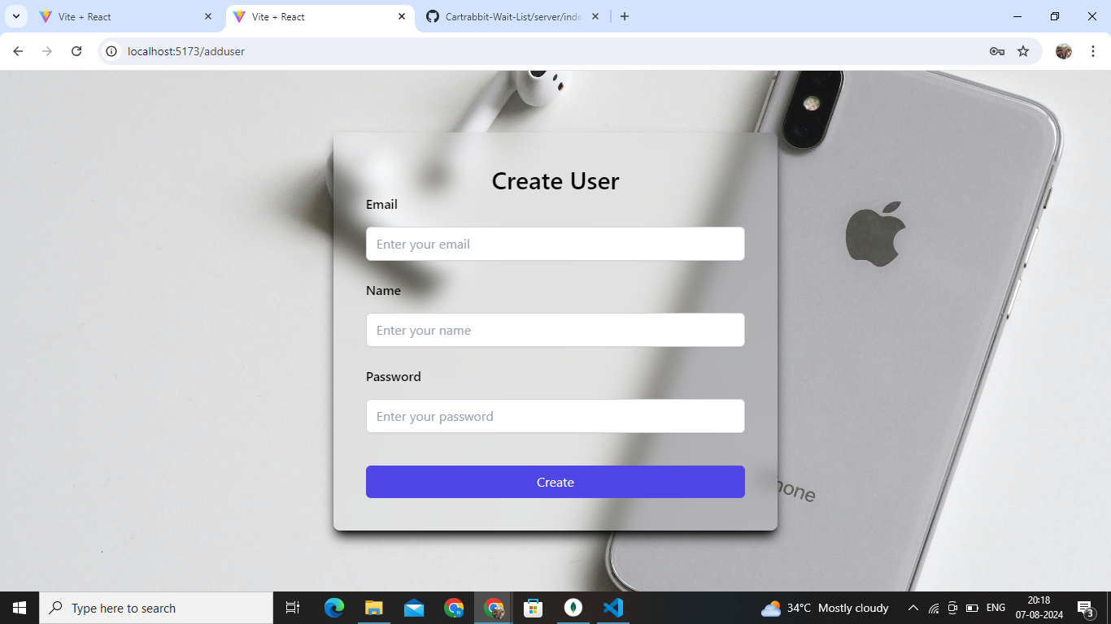

Slide 18
THANK YOU

